Slide 1
Initial Thoughts on Project Data
ISA 401 - Professor Megahed
Team 1
Jaiden Knecht
Sam Peeler
Samuel W. Rogers
Ashley Stratton

Slide 2
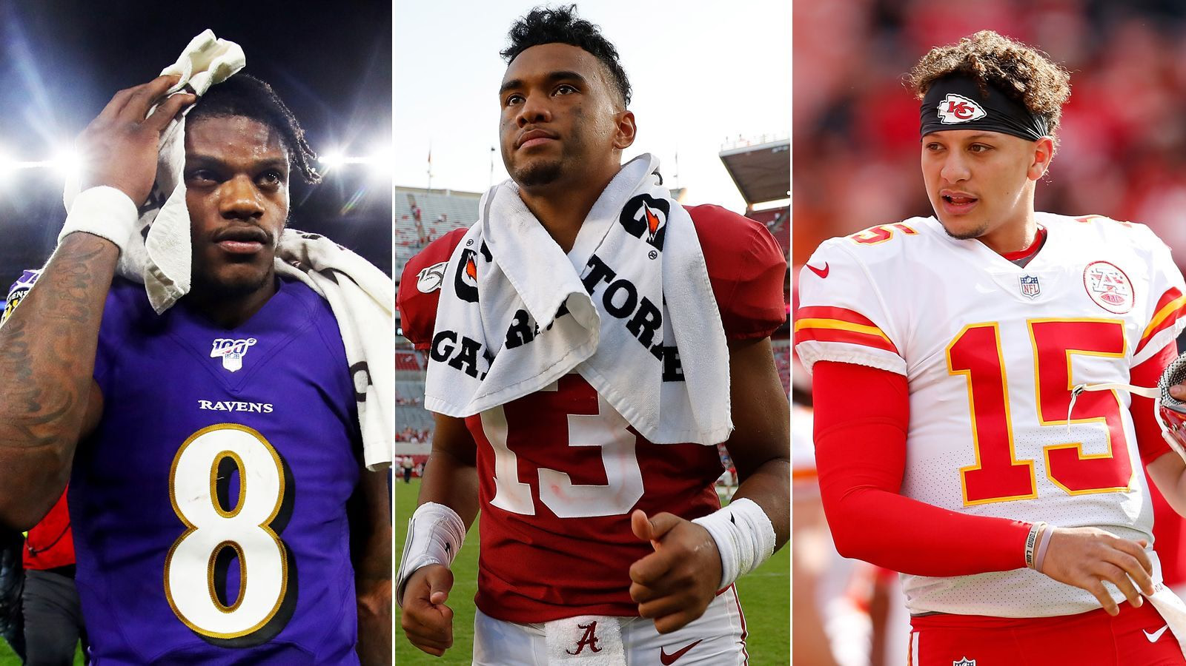
Data Sources
Our team is going in the direction of pulling football data, specifically in the NFL. We will be comparing this player data to players’ wonderlic test scores and salaries in order to determine how well a player performs based on their wonderlic score and salary. We would also like to look into team performance vs team wonderlic score.
Wonderlic Score Database
Sports Reference
Spotrac - Salaries
Pro Football Focus (PFF) - Player Grades

Slide 3

Project Direction & Questions
Overall Question: How do player’s Wonderlic Test scores correlate to their performance in the NFL?
The Wonderlic Test is a cognitive ability test that all players take at the NFL combine in the beginning of their careers
Potential metrics to measure performance
Salary
Average yards/points/blocks (separated by position)
Awards
Sports valuation ratings
True Value Rating (Salary vs. Production Points)
PFF Grade

Slide 4

Additional Information
Challenges
How to accurately aggregate all the data so it makes sense
Inability to drive insight based on our metrics
Comparing player performance contributable to team performance might be rather difficult
Tools We Plan on Using and Testing
R and Rstudio - aggregate the data
Tableau or Power BI - visualize the data and drive insight

